Slide 1
Diligence: The Path to Spiritual Growth
Hebrews 6:7-12

Slide 2
INTRODUCTION:
Diligence is the unwavering commitment and persistence in pursuing our faith with passion and dedication.
It is through diligence that we are able to grow in our relationship with God, bearing the fruit of righteousness.

Slide 3
INTRODUCTION:
However, there are various obstacles that hinder our journey towards becoming diligent disciples.
Today, we will discuss distractions, excuses, laziness, fear of failure, and our past efforts – be it failure or success – that can prevent us from being diligent in our walk with Christ.

Slide 4
Distractions - Focusing Our Hearts and Minds:
  Acknowledge the pervasiveness of distractions in daily life.
  Eliminate and Prioritize

Slide 5
2. Excuses - Taking Responsibility for Our Actions:
A. Recognize the tendency to make excuses to avoid spiritual duties.

Slide 6
Laziness - Embracing a Diligent Spirit:
  Laziness as a barrier to spiritual achievement.
  Commitment, endurance, and zeal are needed in seeking God.

Slide 7
IV. FEAR OF FAILURE
The fear that we may not meet our own or others' expectations can paralyze us, preventing us from taking bold steps of faith.
Consider the Parable of the Talents (Matthew 25:24-30).

Slide 8
IV. FEAR OF FAILURE
With God as our guide, we can overcome our fear of failure and diligently pursue His will for our lives.
We are called to trust in His strength, lean on His promises, and persevere even when faced with potential setbacks.

Slide 9
V. OUR PAST EFFORTS
Reflecting on our experiences can either propel us forward in diligence or hold us back.
Past successes may lead us to complacency, assuming that we have already arrived.

Slide 10
V. OUR PAST EFFORTS
Conversely, past failures may breed discouragement, causing us to doubt our ability to diligently follow Christ.
However, scripture calls us to forget what is behind and press on toward the goal to win the prize for which God has called us (Philippians 3:13-14).

Slide 11
V. OUR PAST EFFORTS
Let us learn from our past (success or failure), embracing every opportunity to grow and being diligent in our pursuit of holiness.
WE MUST CONTINUE TO WORK! (Gal. 6:9, 1 Cor. 15:58)

Slide 12
CONCLUSION:
We have explored the importance of diligence in our walk with Christ and the hindrances that can prevent us from becoming diligent disciples.

Slide 13
CONCLUSION:
It is our responsibility to remain focused, be accountable, reject laziness, overcome fear, and learn from our experiences.

Slide 14
CONCLUSION:
Let us heed the words of Hebrews 6:11-12, "And we desire that each one of you show the same diligence to the full assurance of hope until the end, that you do not become sluggish, but imitate those who through faith and patience inherit the promises."

Slide 15
CONCLUSION:
May the Holy Spirit empower us and may we encourage each other to be diligent disciples, bearing fruits of righteousness and growing in our relationship with God!

Slide 16
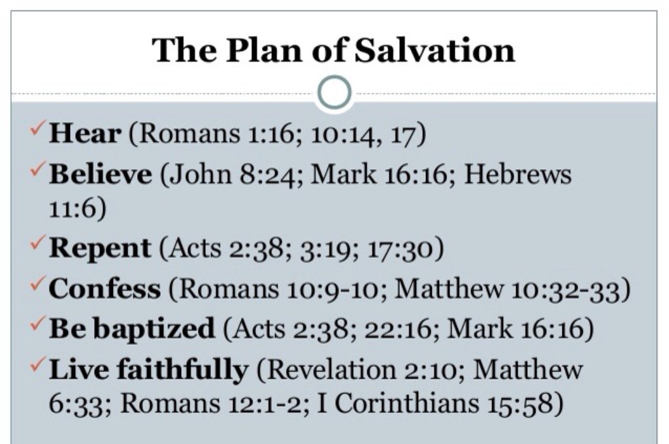

Slide 17
Diligence: The Path to Spiritual Growth
Hebrews 6:7-12

Slide 18
INTRODUCTION:
Diligence is the unwavering commitment and persistence in pursuing our faith with passion and dedication.
It is through diligence that we are able to grow in our relationship with God, bearing the fruit of righteousness.

Slide 19
INTRODUCTION:
However, there are various obstacles that hinder our journey towards becoming diligent disciples.
Today, we will discuss distractions, excuses, laziness, fear of failure, and our past efforts – be it failure or success – that can prevent us from being diligent in our walk with Christ.

Slide 20
I. DISTRACTIONS
Our daily lives can be consumed by an array of distractions, ranging from the trivial to the burdensome.
Consequently, these distractions divert our attention from nurturing our relationship with God.

Slide 21
I. DISTRACTIONS
Technology, social media, unhealthy relationships, materialism, and hectic schedules often consume our time and energy, leading us away from diligently seeking God.

Slide 22
I. DISTRACTIONS
Paul urges us to focus on God rather than distractions
1Co 7:35 NKJV And this I say for your own profit, not that I may put a leash on you, but for what is proper, and that you may serve the Lord without distraction.

Slide 23
I. DISTRACTIONS
Lessons about being distracted:
Mary and Martha (Luke 10:38-42)
The Parable of the Sower (Mark 4:18-19).

Slide 24
I. DISTRACTIONS
To be diligent disciples, we must focus our hearts and minds on that which is eternal and prioritize our spiritual growth against the temporal distractions that surround us.

Slide 25
II. EXCUSES
We must recognize the tendency to make excuses to avoid spiritual duties.
We may find excuses like being too busy, feeling unworthy, or lacking the necessary resources to diligently pursue God.

Slide 26
II. EXCUSES
Illustration of excuse-making futility - The Great Supper Parable (Luke 14:16-20)

Slide 27
II. EXCUSES
God calls us to be accountable for our actions and encourages us to trust in His provision.
Let us cast aside excuses and commit to seeking God wholeheartedly, knowing that in our weakness, God's strength is made perfect.

Slide 28
III. LAZINESS
Laziness has the power to prevent us from reaching our full potential in Christ.
It is an attitude of complacency, a lack of initiative, and an unwillingness to invest time and effort in our spiritual growth.

Slide 29
III. LAZINESS
Proverbs serves as a resource to inspire industry over idleness and inactivity (Proverbs 6:6-11; 13:4;
26:13-16).

Slide 30
III. LAZINESS
Diligence requires discipline, perseverance, and a desire to seek God fervently.
To combat laziness, we must cultivate a diligent spirit by consistently prioritizing prayer, Bible study, and fellowship with fellow believers.

Slide 31
III. LAZINESS
Let us be willing to invest the necessary effort, knowing that the reward of a deeper relationship with God is immeasurable.

Slide 32




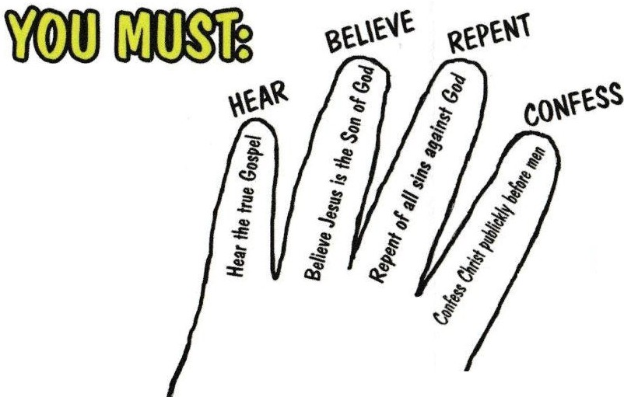
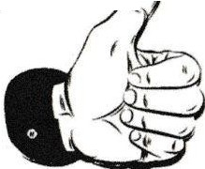
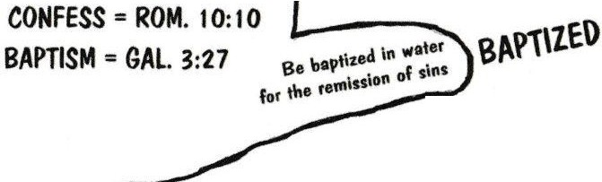
HEAR
John 6:45,
Rom. 10:14-17
BELIEVE
He&. 11:6, John 8:24,
Rom. 1:16, Rom. 10:10
REPENT
Luke 13:3, Acts 17:30,
2 Cor. 7:10, 2 Pet. 3:9
CONFESS
Acts 8:37, Rom. 10:10
Matt. 10:32, Luke 12:8
BAPTISM
Mark 16:16, Acts 2:38, Acts 22:16,
1 Pet. 3:21, Rom. 6:3-4, Gal. 3:27
HEAR BELIEVE REPENT CONFESS
+ BAPTISM
CH /
John 10:1-S
Matt. 7:21
Luke 6:46
2 Tim. 2:S
' "
HEAR= ROM. 10:17
BELIEVE = JOHN 8:24
REPENT = ACTS 17:30
2 Tim. 2:10
·rjI \I Be faithful unt_ildeath
I ��� Rev. 2:10, 2 Tim. 4:6-8

